Slide 1
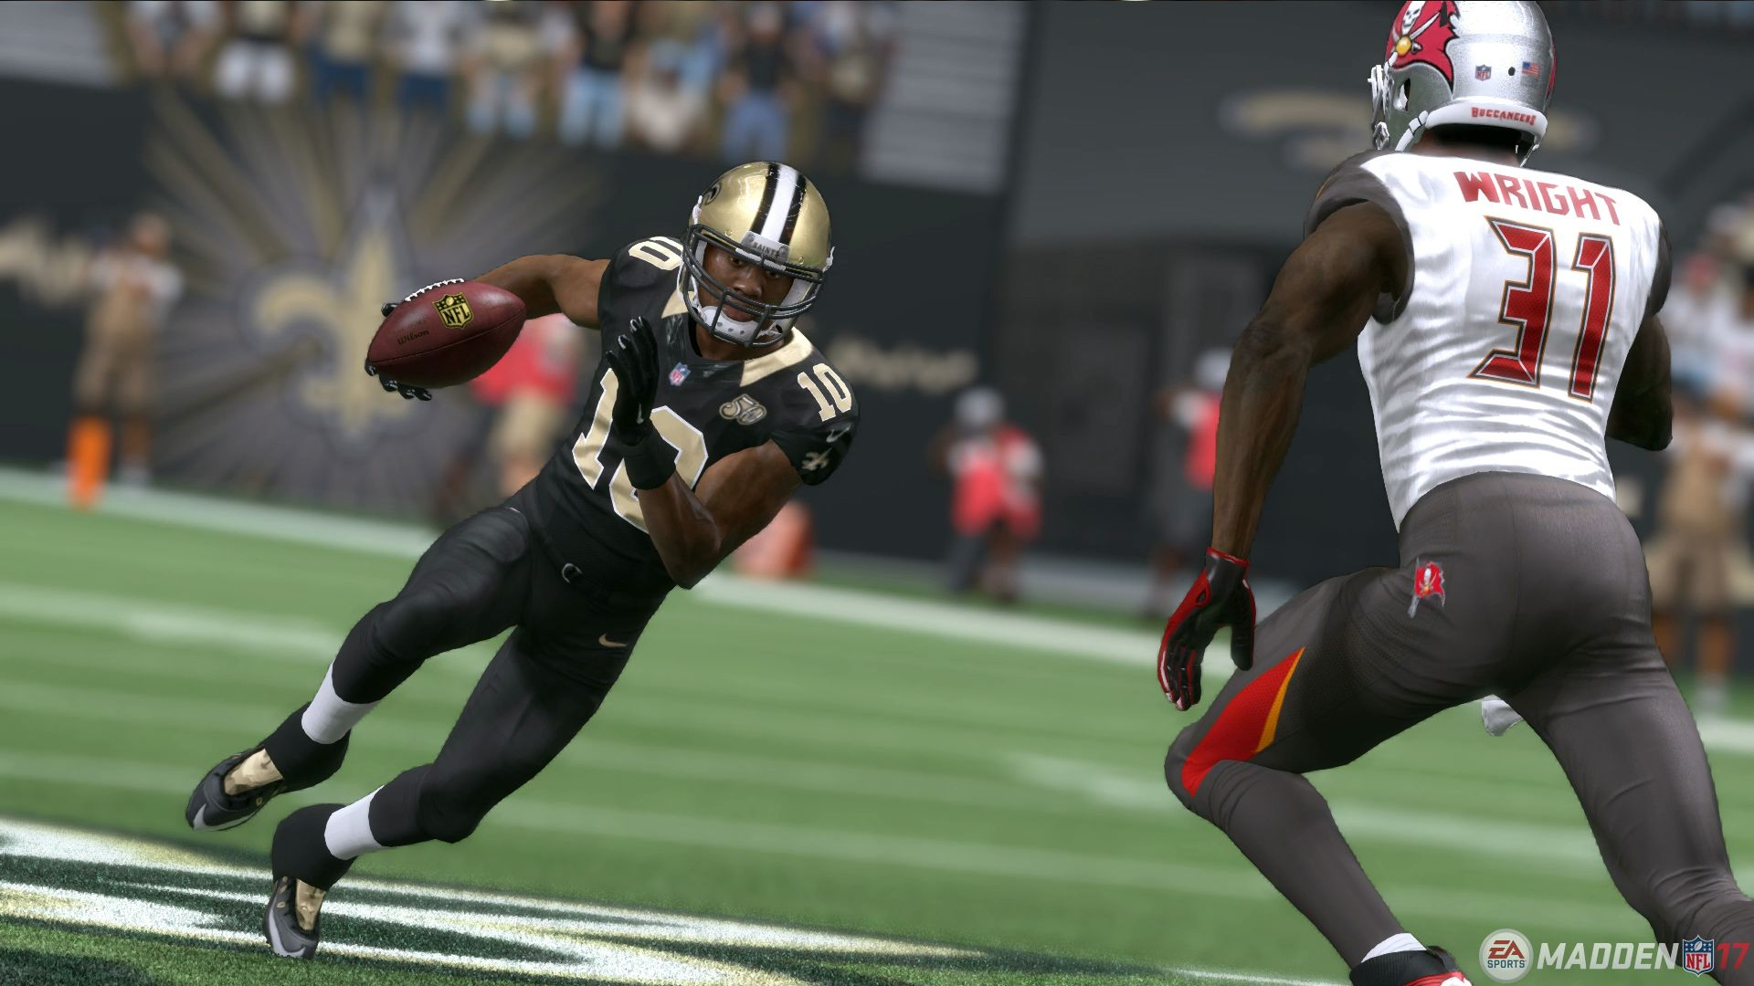
Project Proposal: NFL : National Football League

Slide 2
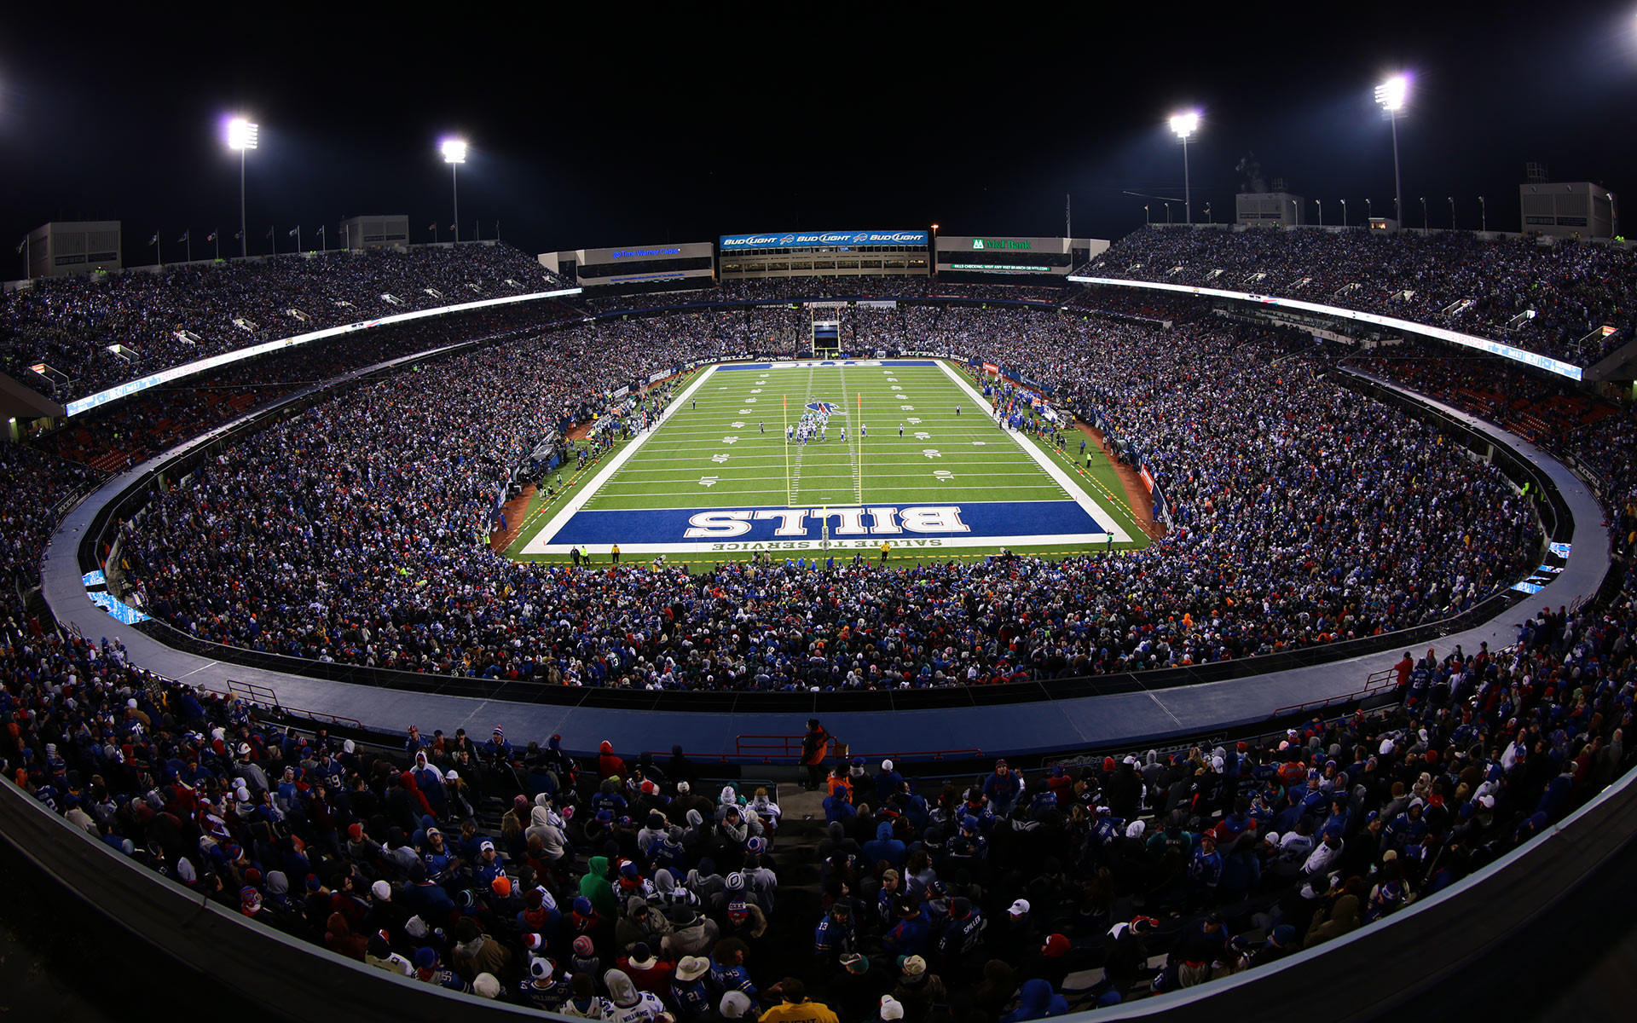
NFL
Data Analysts working on this project :
Venkata Lakshmi Nikhila Katiki
Bhagirath Reddy vulupala
Sindhuja Pulluri
Revanth Pavan Nimmala
Gnana Prasuna Pulipaka
Kausik Valeti

Slide 3
NFL
The National Football League is a professional American football league consisting of 32 teams, divided equally between the National Football Conference and the American Football Conference.
Today, the NFL has the highest average attendance (67,591) of any professional sports league in the world and is the most popular sports league in the United States.
The Super Bowl is also among the biggest club sporting events in the world, with the individual games accounting for many of the most watched television programs in American history.
Since based on the statistical data and demand for NFL, challenges data analysts to predict Yards.
Source of the dataset is from Kaggle (https://www.kaggle.com/c/nfl-big-data-bowl-2020/data)

Slide 4
NFL
Here we going to predict How many yards will an NFL player gain after receiving a handoff?
In this, Yards is our response variable (Dependent variable) whereas remaining all other variables are our predictors (Independent Variables).

Slide 5
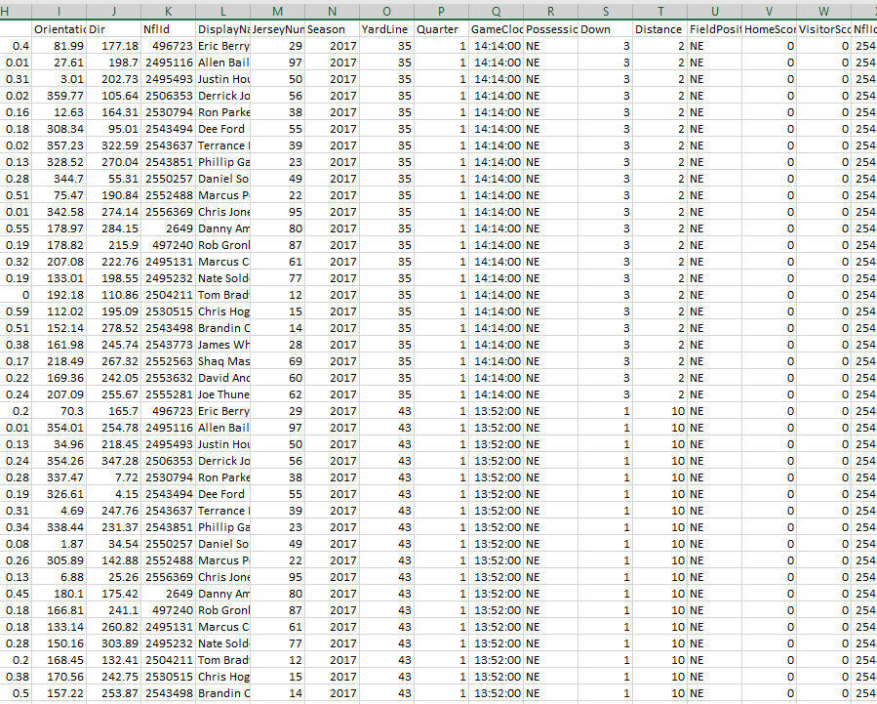
NFL
Here is the sample of our data set, size of 176 MB having 509,763 rows and 49 columns.
Once we pre-process the data, the rows are cut down to 375,786 rows.

Slide 6
DATA SET VARIABLES AND ITS DETAILS:
GameId - a unique game identifier | Dis - distance traveled from prior time point, in yards | YardLine - the yard line of the line of scrimmage | HomeScoreBeforePlay - home team score before play started | PlayDirection - direction the play is headed | PlayerCollegeName - where the player attended college | WindDirection - wind direction
PlayId - a unique play identifier | Orientation - orientation of player | Quarter - game quarter (1-5, 5 == overtime) | VisitorScoreBeforePlay - visitor team score before play started | TimeHandoff - UTC time of the handoff | Position - the player's position | WindSpeed - wind speed in miles/hour
Team - home or away | Dir - angle of player motion | Game Clock - time on the game clock | NFL Id Rusher - the NFL Id of the rushing player | TimeSnap - UTC time of the snap | HomeTeamAbbr - home team abbreviation | Humidity - humidity
X - player position along the long axis of the field. | NFL Id - a unique identifier of the player | PossessionTeam - team with possession | OffenseFormation - offense formation | Yards - the yardage gained on the play | VisitorTeamAbbr - visitor team abbreviation | Temperature - temperature (deg F)
Y - player position along the short axis of the field | DisplayName - player's name | Down - the down (1-4) | Offense Personnel - offensive team positional grouping | PlayerHeight - player height (ft-in) | Week - week into the season | GameWeather - description of the game weather
S - speed in yards/second | JerseyNumber - jersey number | Distance - yards needed for a first down | DefendersInTheBox - number of defenders lined up near the line of scrimmage, spanning the width of the offensive line | PlayerWeight - player weight (lbs) | Stadium - stadium where the game is being played | Turf - description of the field surface
A - acceleration in yards/second^2 | Season - year of the season | FieldPosition - which side of the field the play is happening on | DefensePersonnel - defensive team positional grouping | PlayerBirthDate - birth date (mm/dd/yyyy) | Location - city where the game is being player | Stadium Type - description of the stadium environment

Slide 7
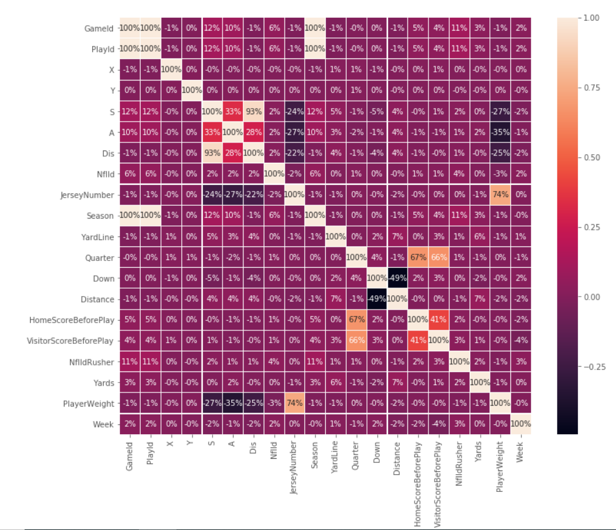
CORRELATION PLOT FOR ALL THE VARIABLES

Slide 8
DATA PRE-PROCESSING FOR RAW DATA
We pre-processed the data by removing the text columns which is not necessary for predicting our response variable (Yards) ,we also removed Null values which does not impact much on our dataset to predict our response variable.

Slide 9
HIGH LEVEL SUMMARY OF CLEANED DATASET

Slide 10
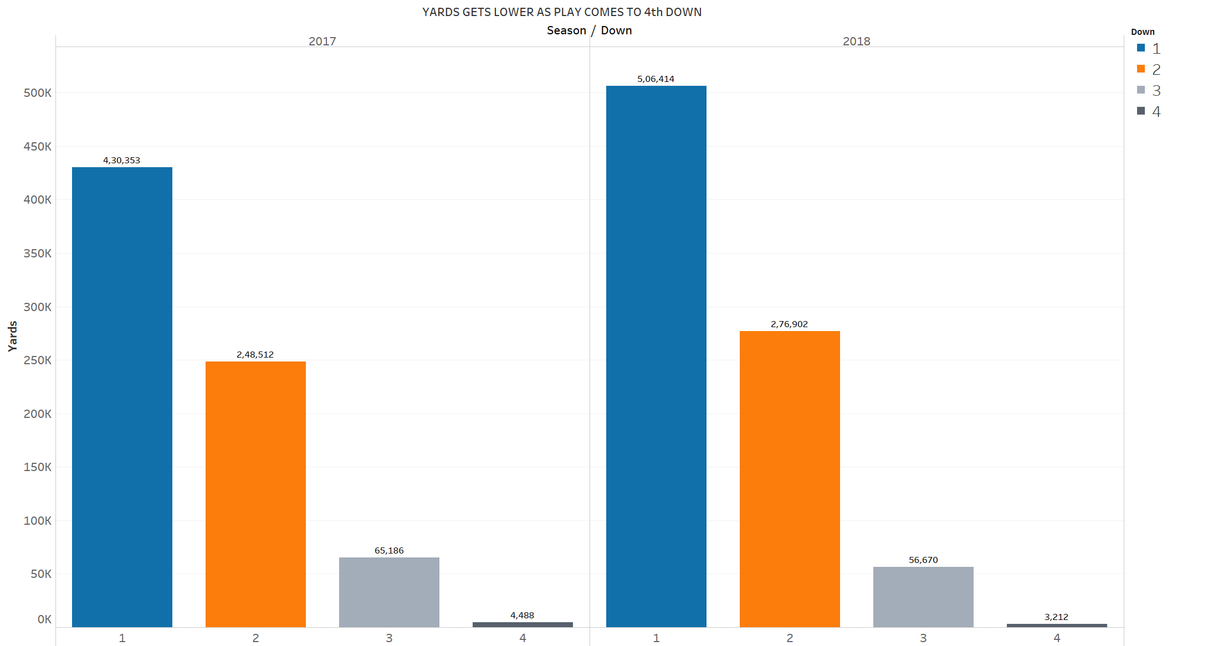
In the first down we can observe every team scores more yards when compared to 2nd ,3rd & 4th down.
As the game progress to the 4th down, gaining of yards gets difficult in both the seasons (2017 & 2018)

Slide 11
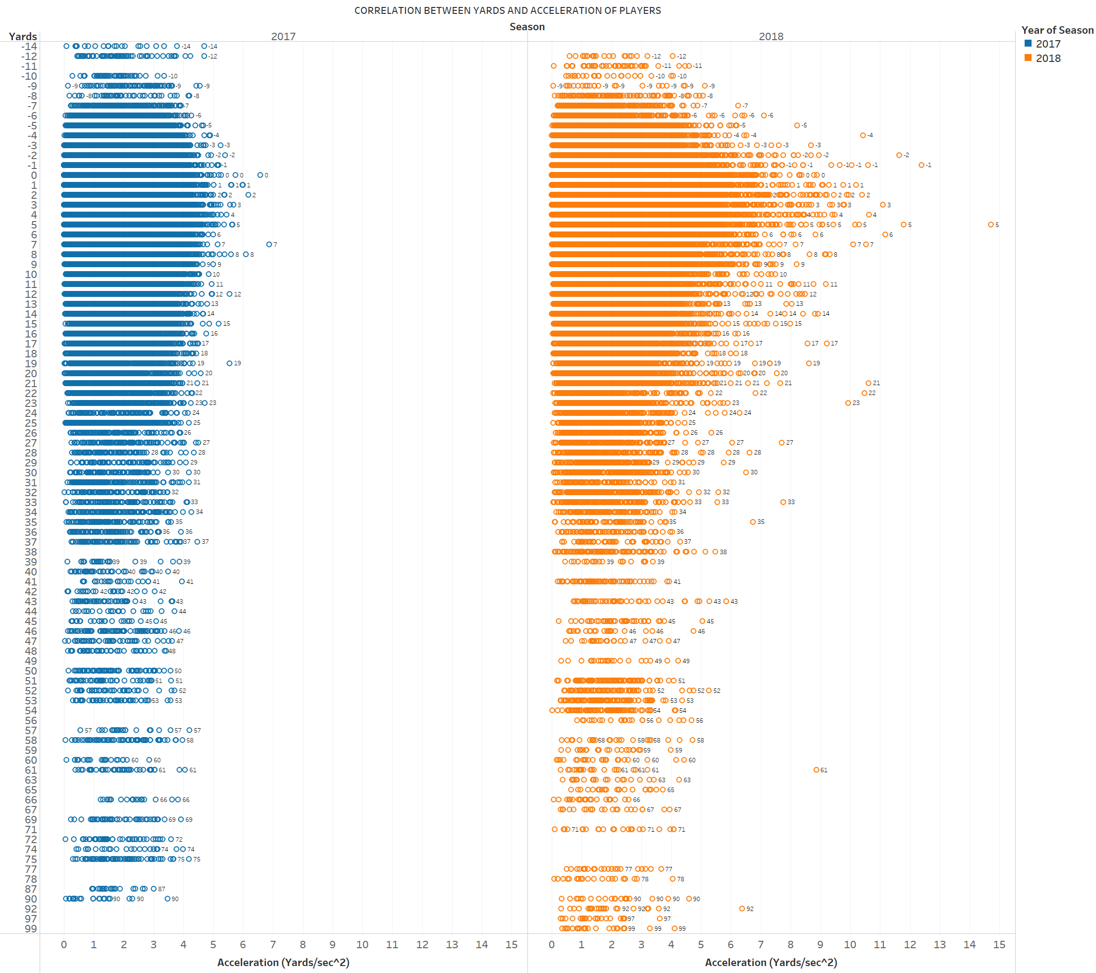
As you can see the players who had less acceleration got sacked and also covered more number of Yards in both seasons( 2017&2018)
From this there is no correlation between Yards and Acceleration
Players whose acceleration is more than 8 Yards/sec^2 are not able to gain more yards for their team, because there is more chance for fumble.

Slide 12
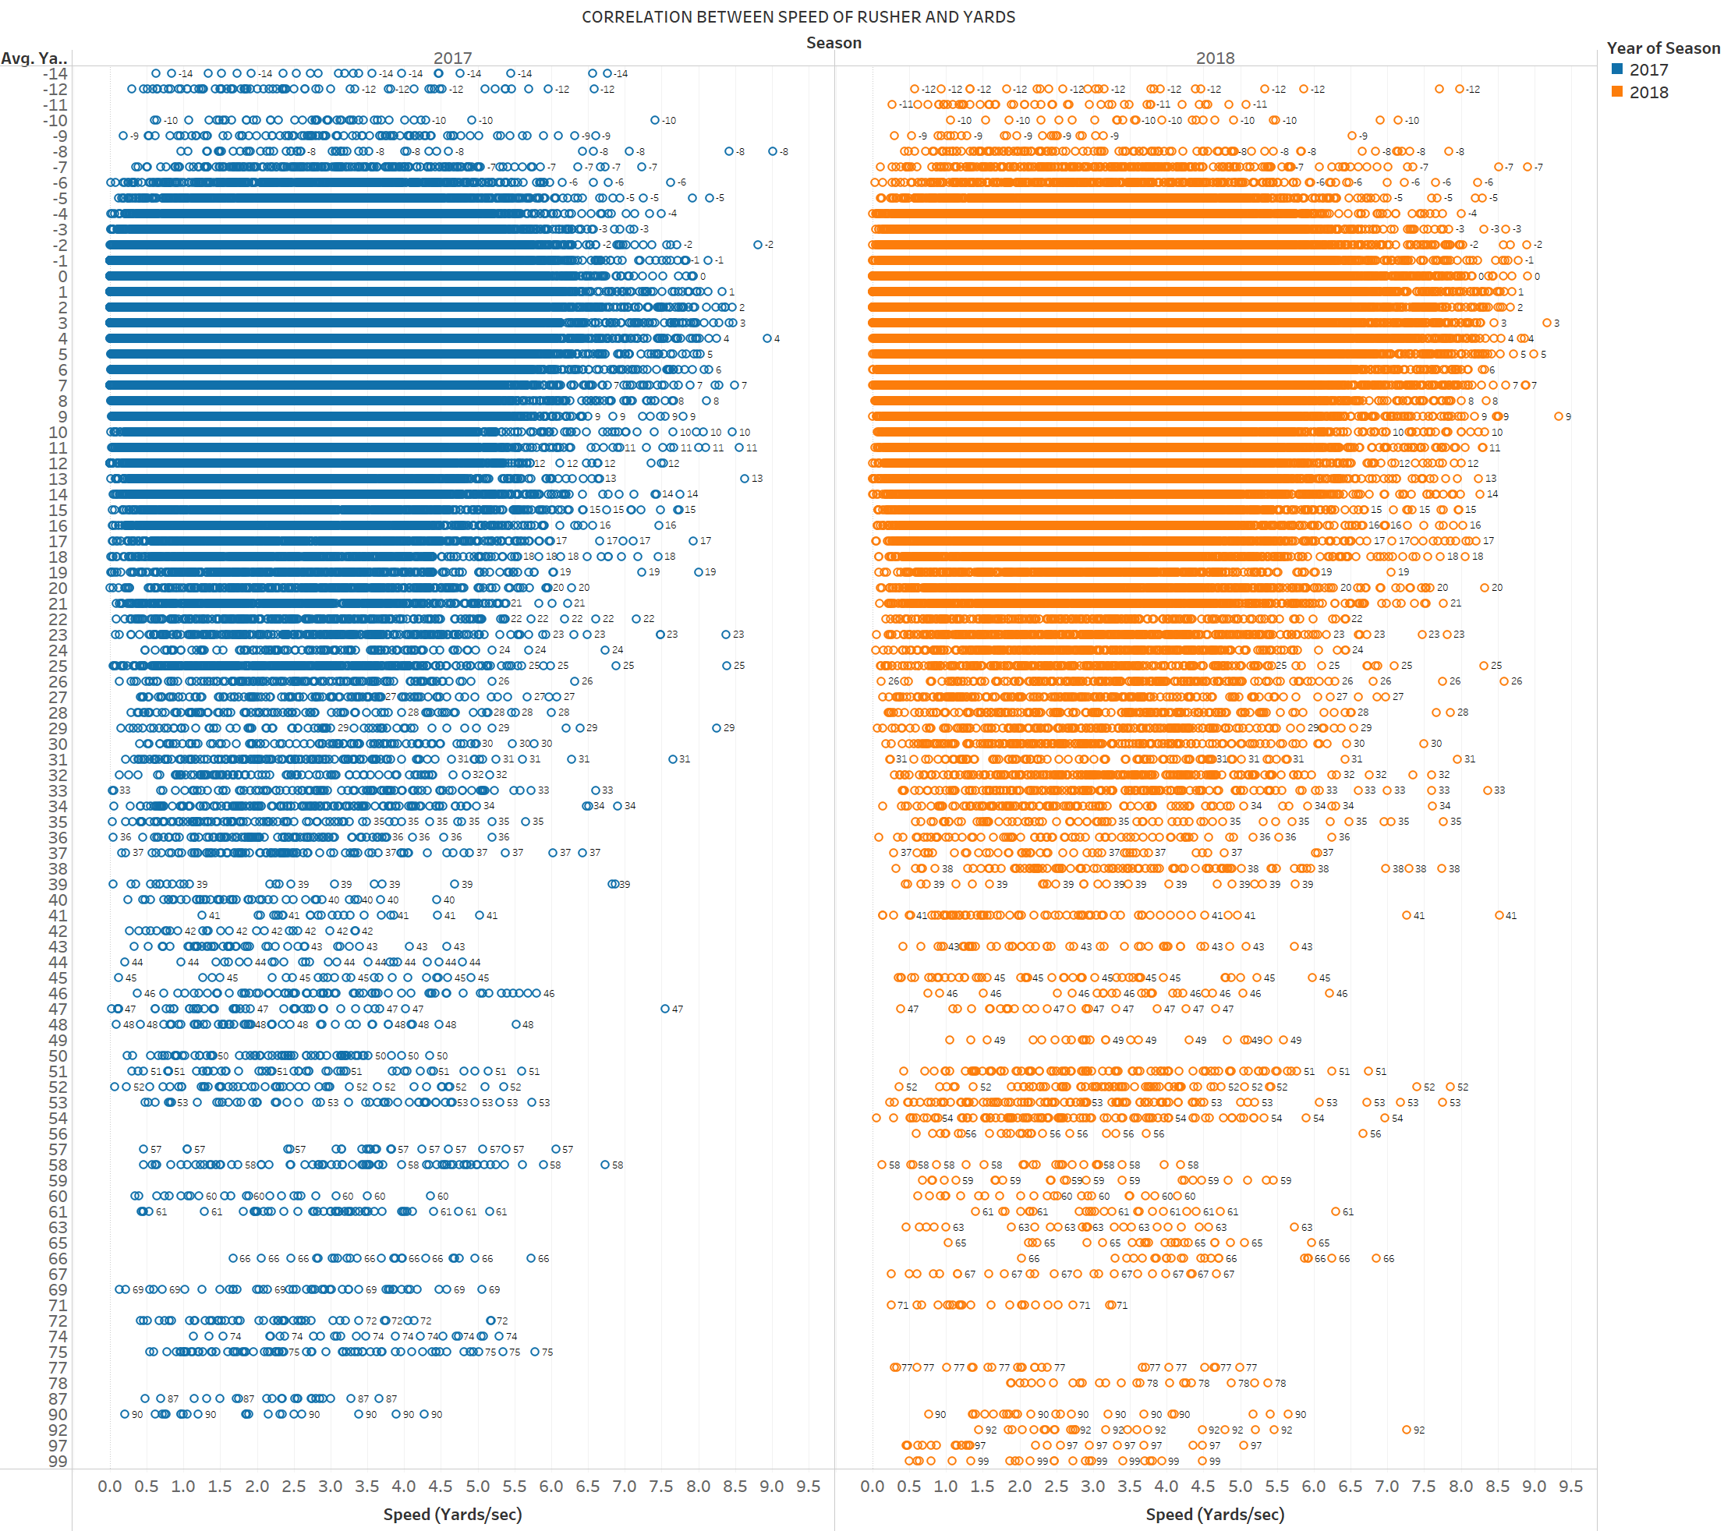
As you can see the players who had less Speed got sacked and also covered more number of Yards in both seasons( 2017&2018)
From this there is no correlation between Yards and Speed
Players whose Speed is more than 6 Yards/sec are not able to gain more yards for their team, because there is more chance for fumble.

Slide 13
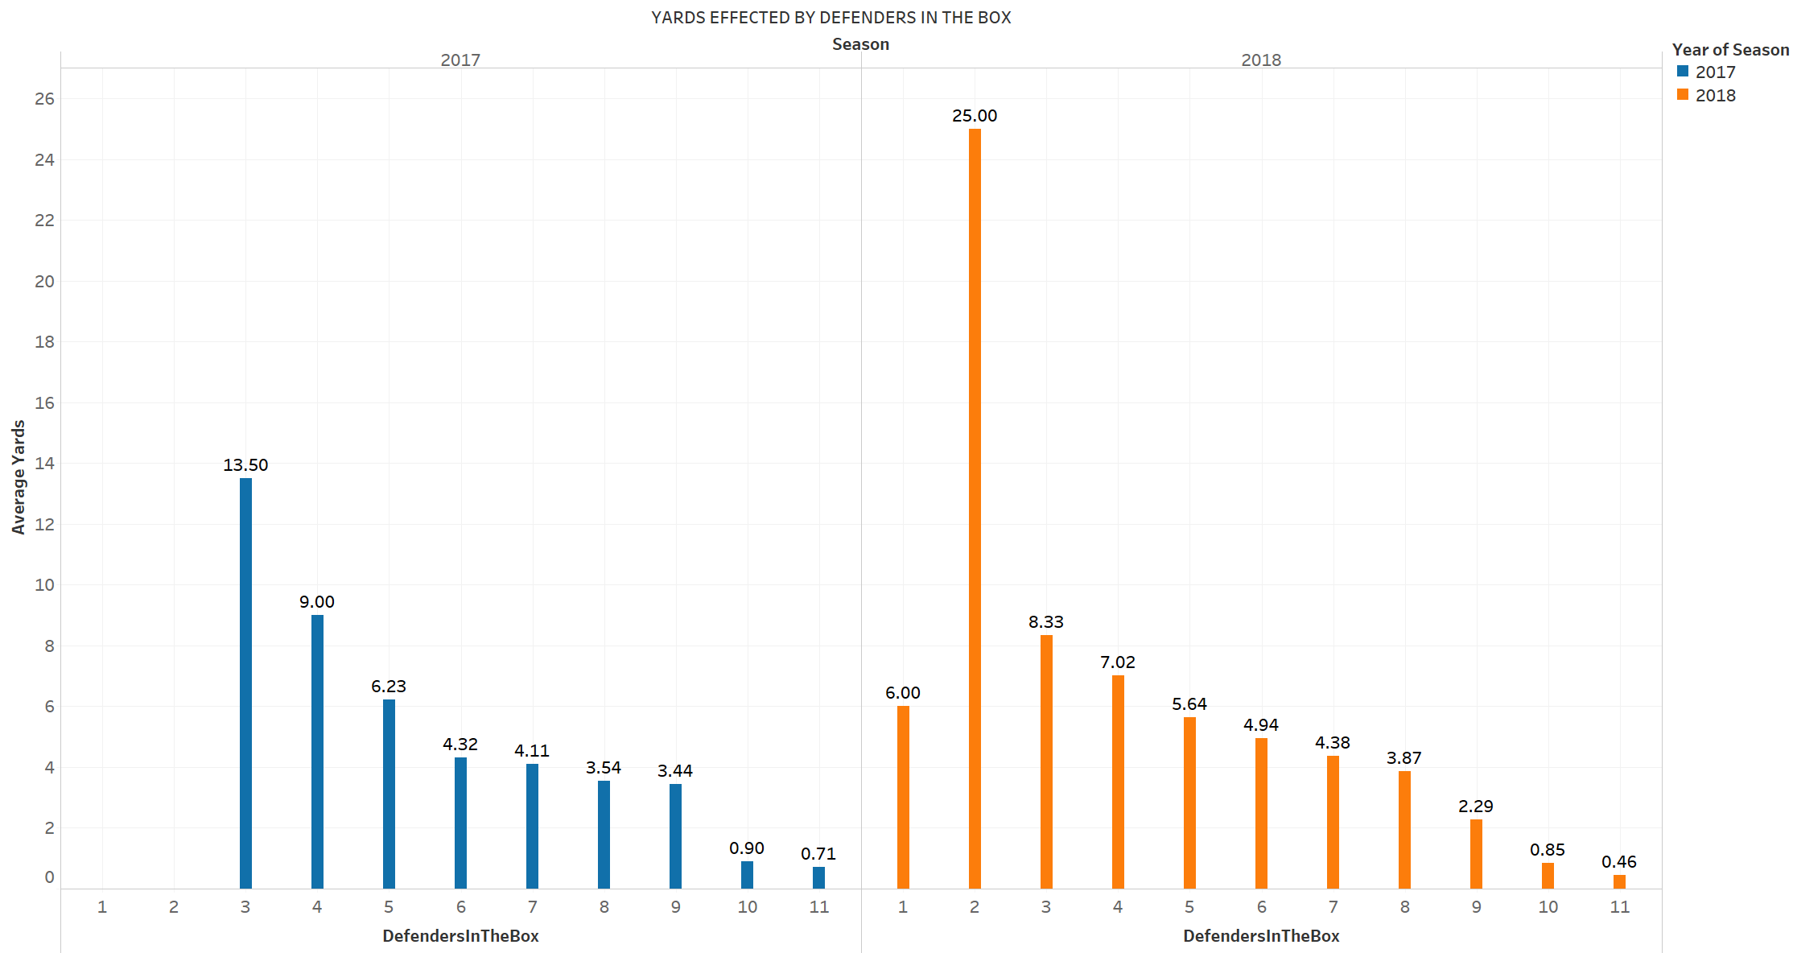
As the defenders increases above 9 in box, scoring yards gets difficult.

Slide 14
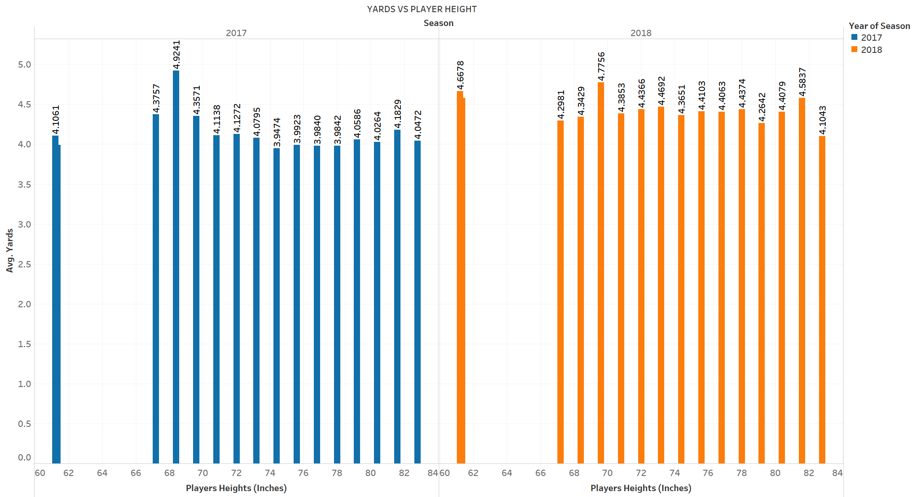
From the graph, Player height does not impact in gaining yards.

Slide 15
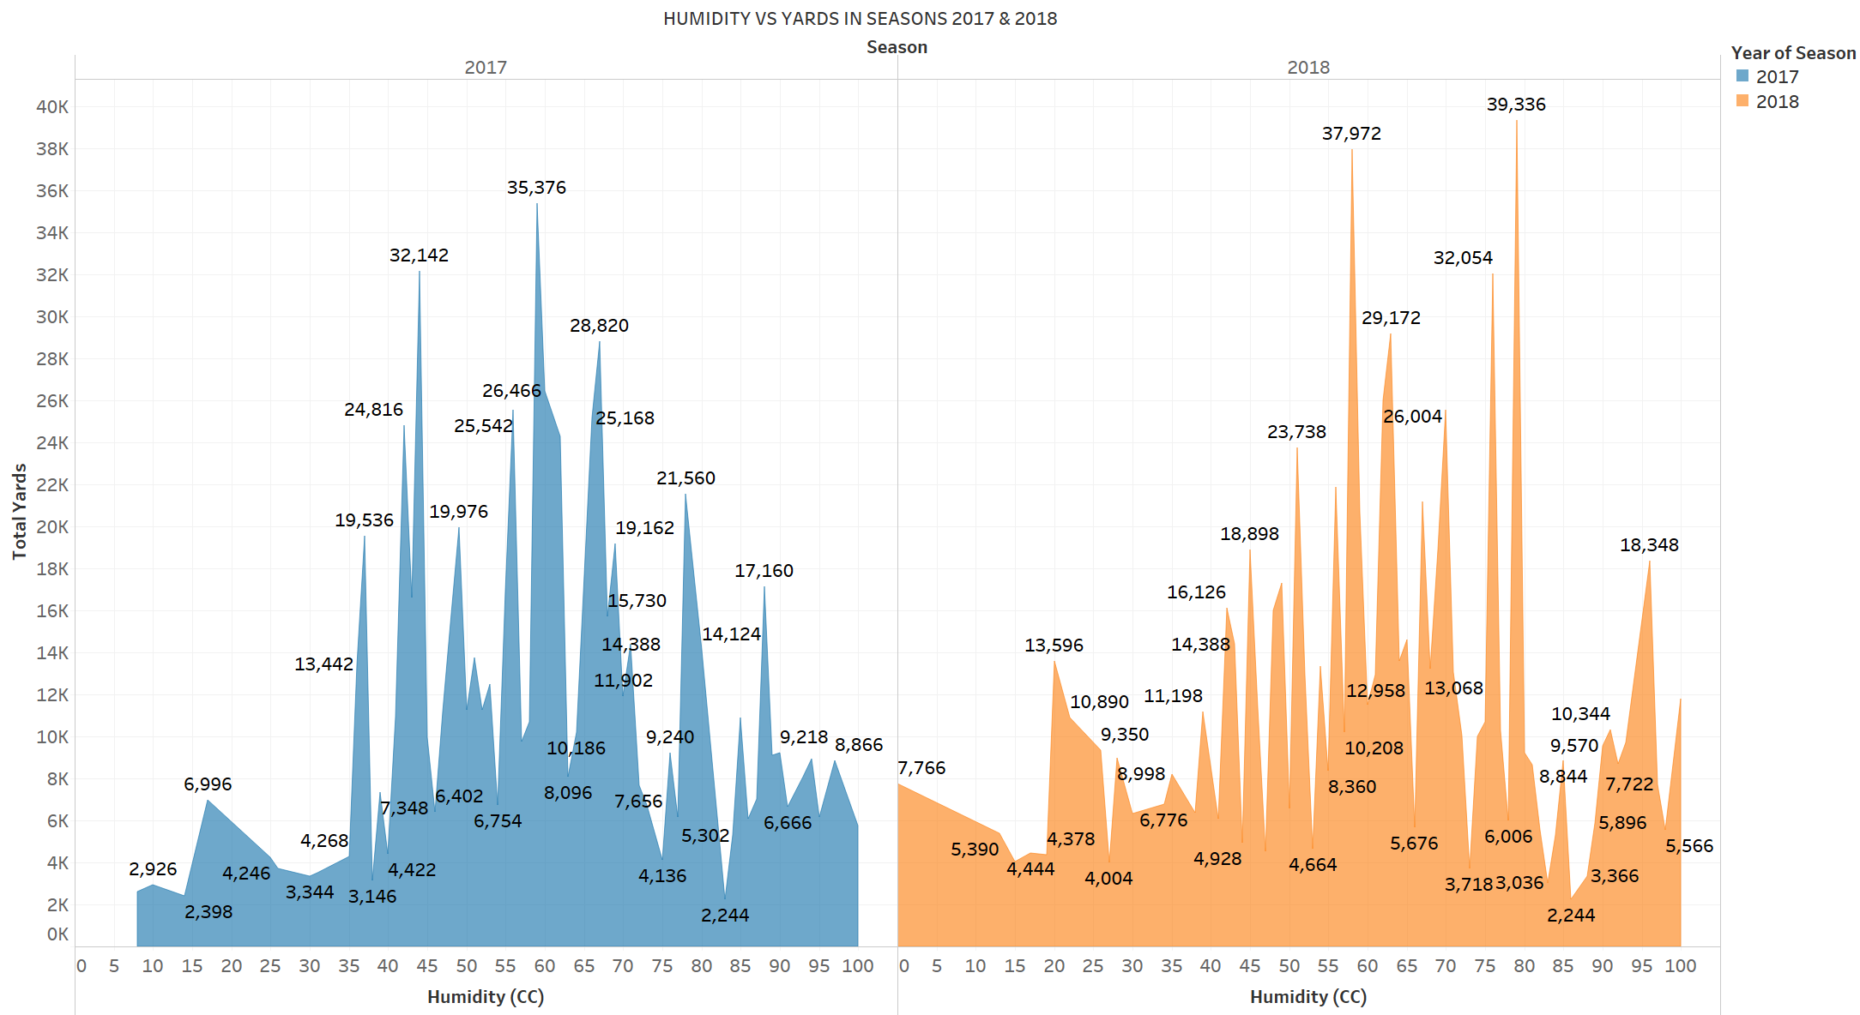
When the humidity is low and high, scoring Yards gets difficult.

Slide 16
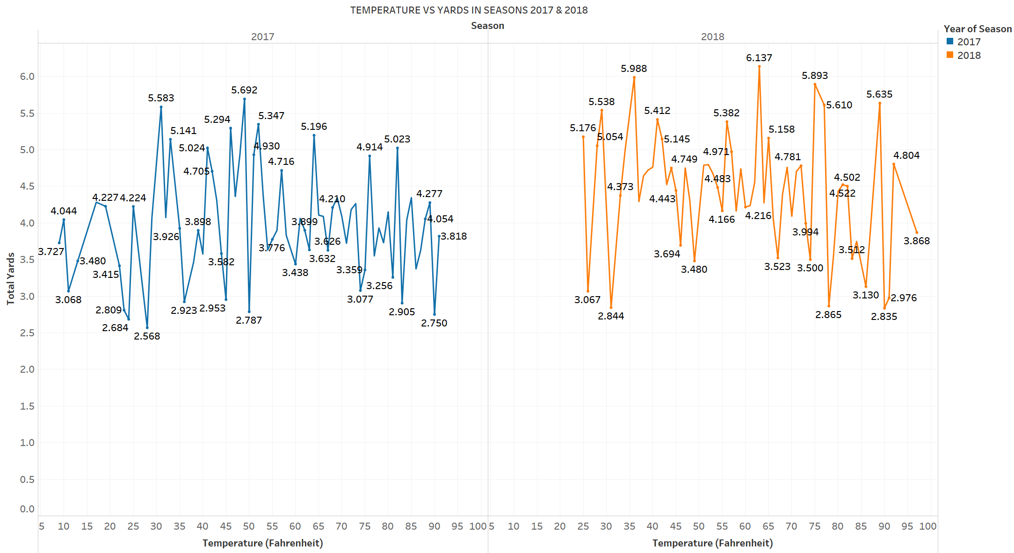
When the temperature is low and high, scoring Yards gets difficult.

Slide 17
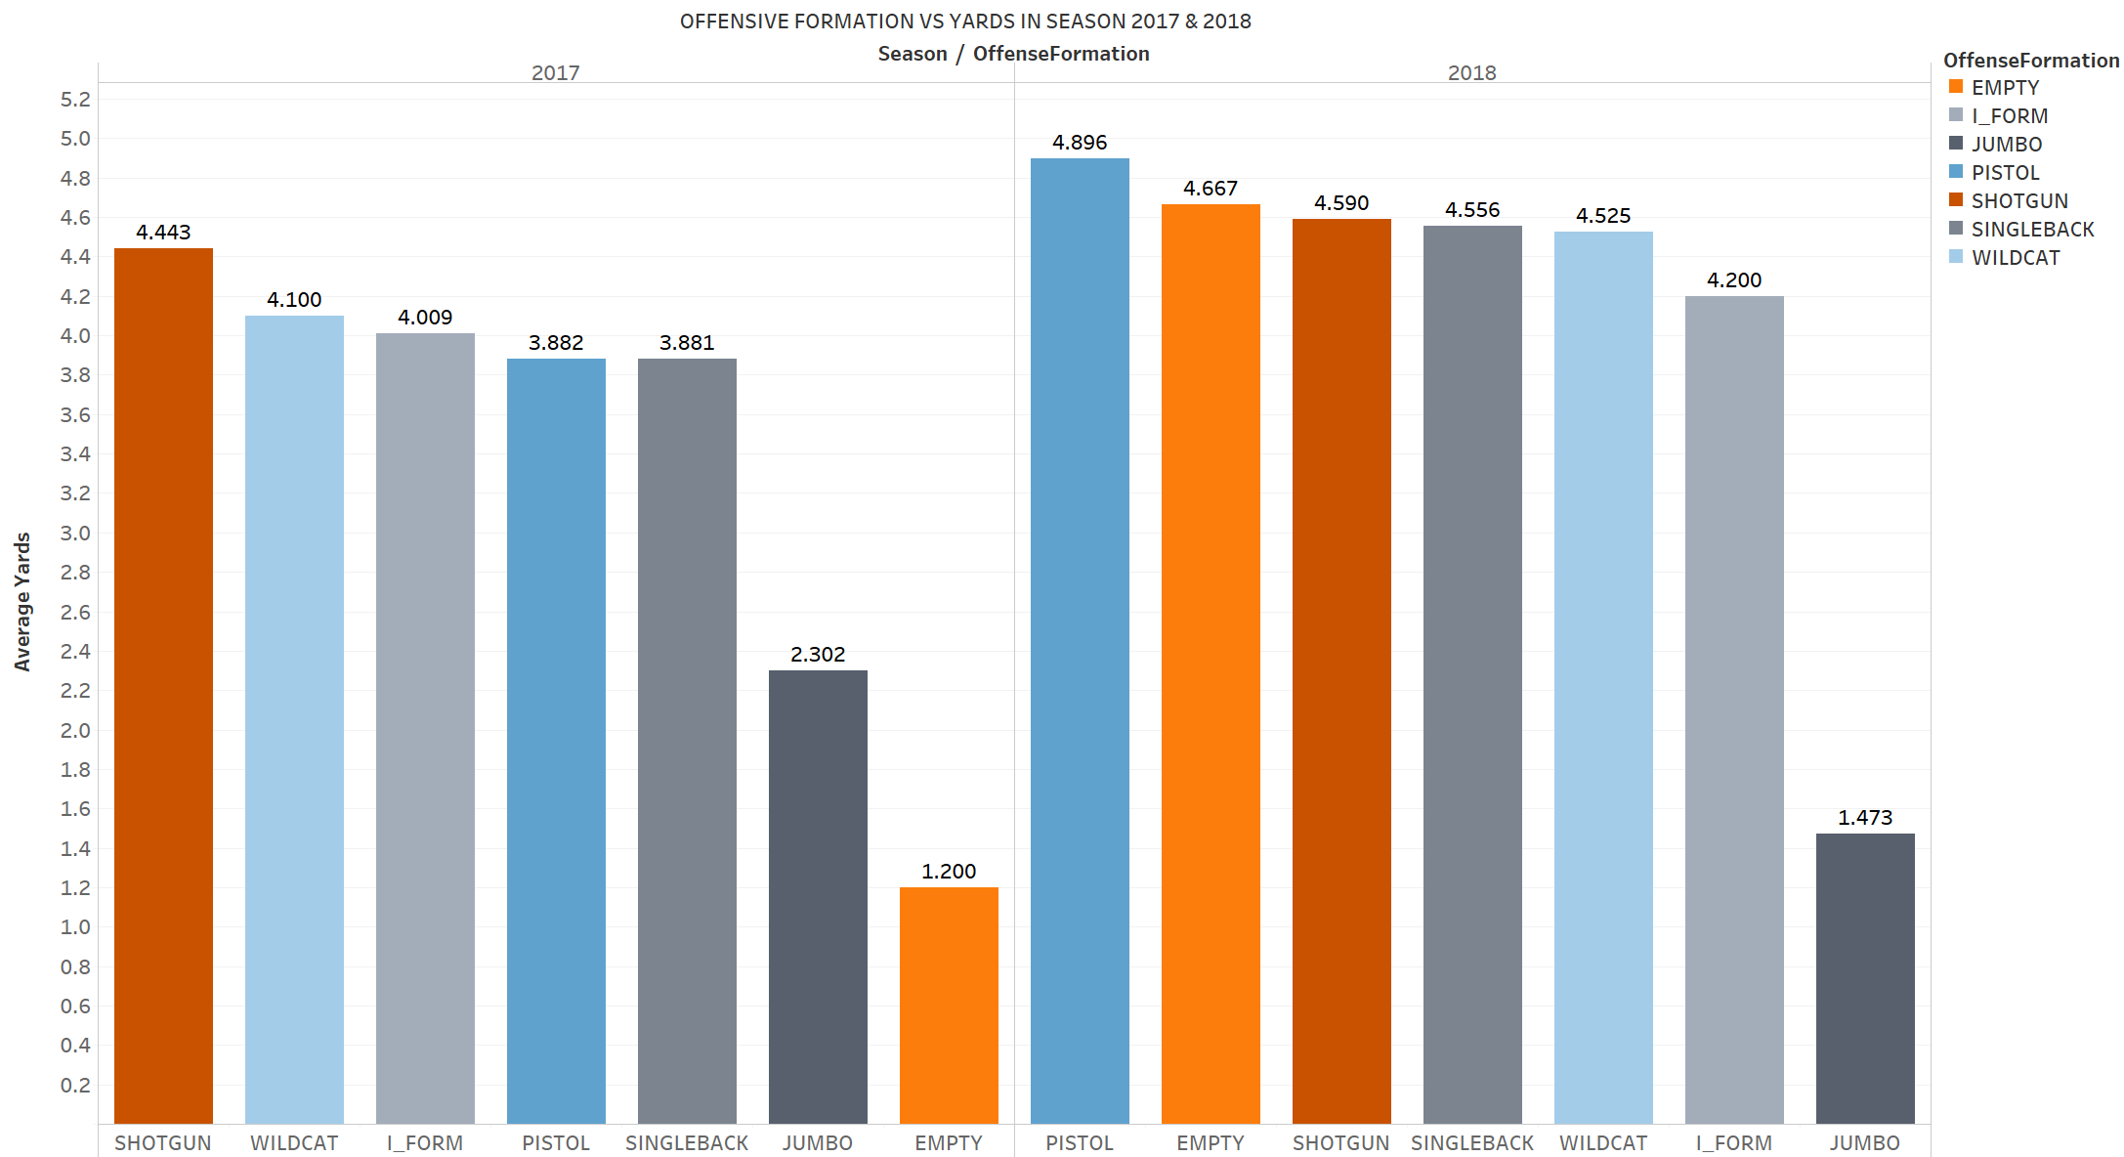
Top 3 Offensive formations are SINGLEBACK,SHOTGUN & I_FORM

Slide 18
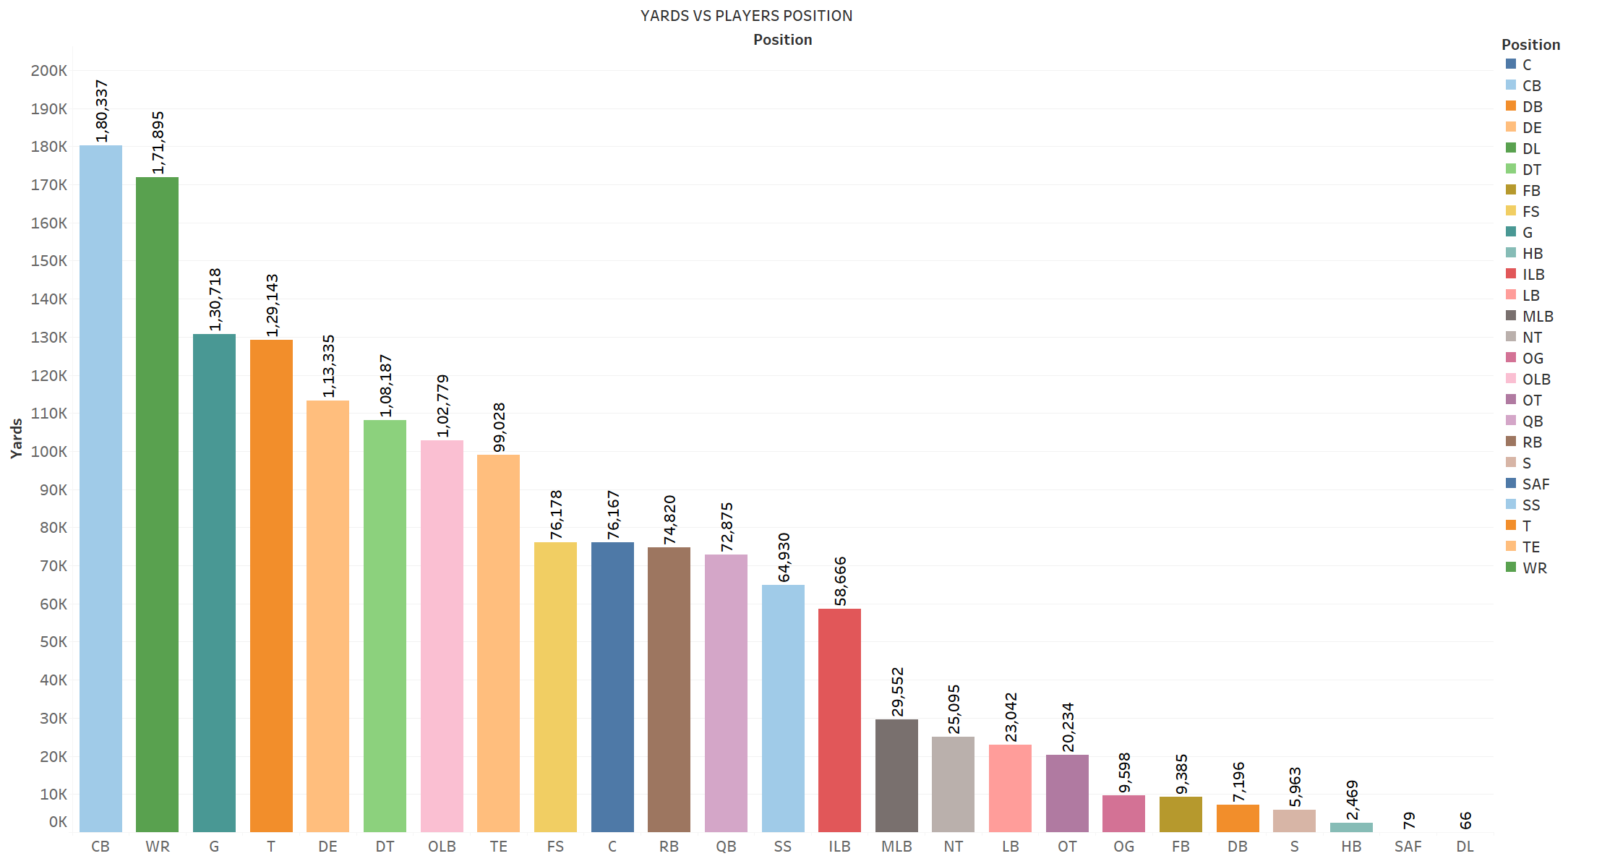
WR(wide receivers) & CB( Corner back) scores more Yards for their teams.

Slide 19
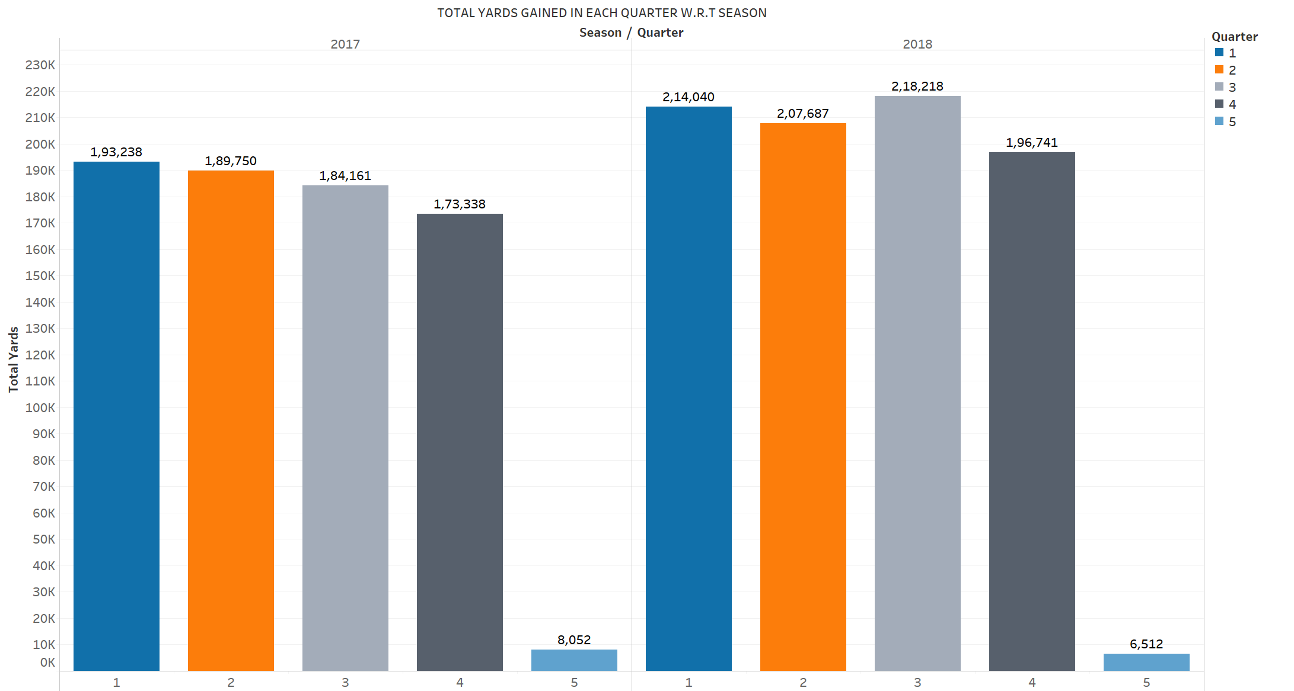
Every team scores in all the 4 quarters similarly, so there is no relationship between Quarters and Yards.

Slide 20
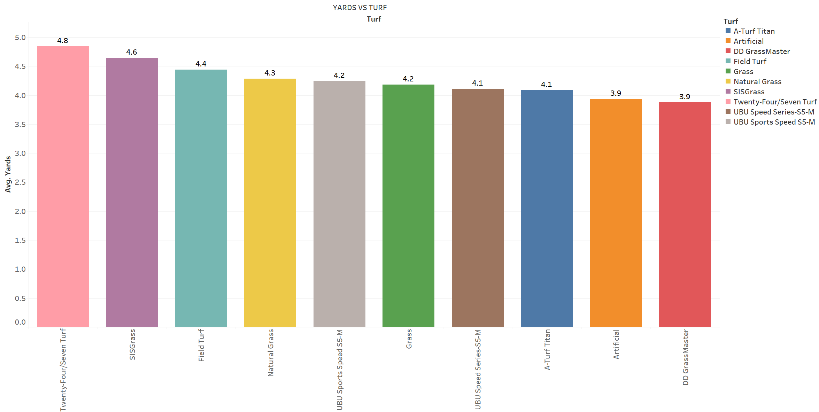
In all the Turfs we observe mostly similar number of Avg. Yards gained, so there is no Correlation between Turf and Yards

Slide 21
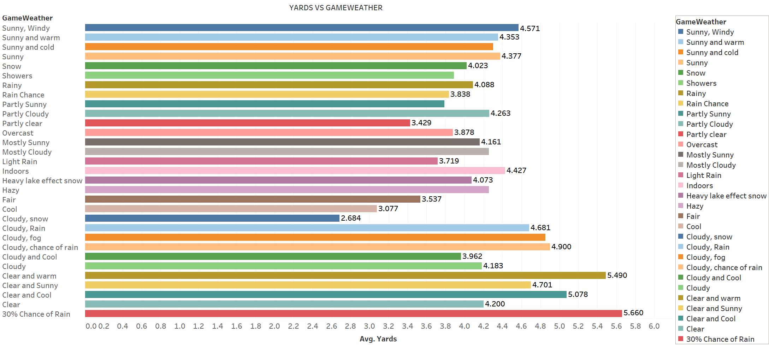
When Weather is Sunny & Cloudy more number of Yards can be scored.

Slide 22
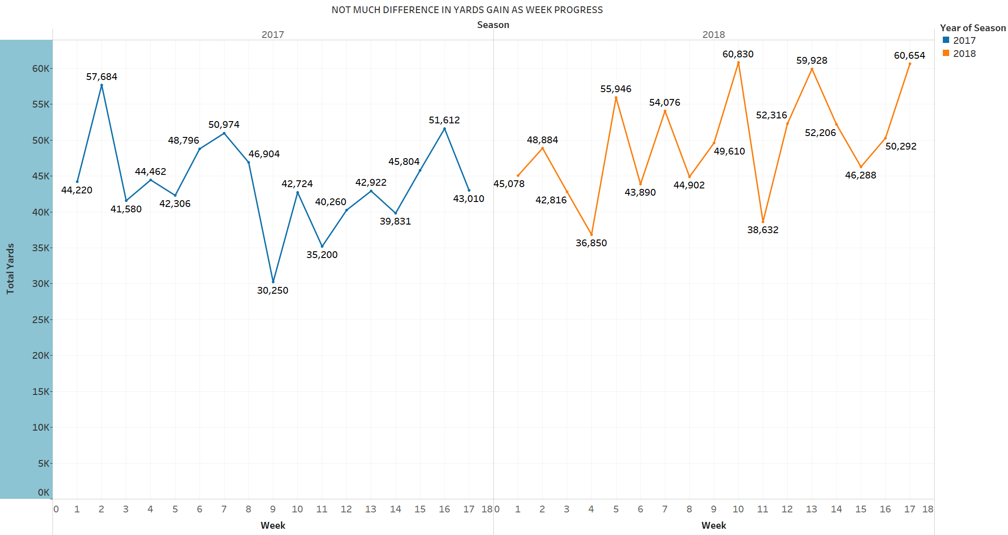
There is no Correlation between Yards gained with respective to weeks.

Slide 23
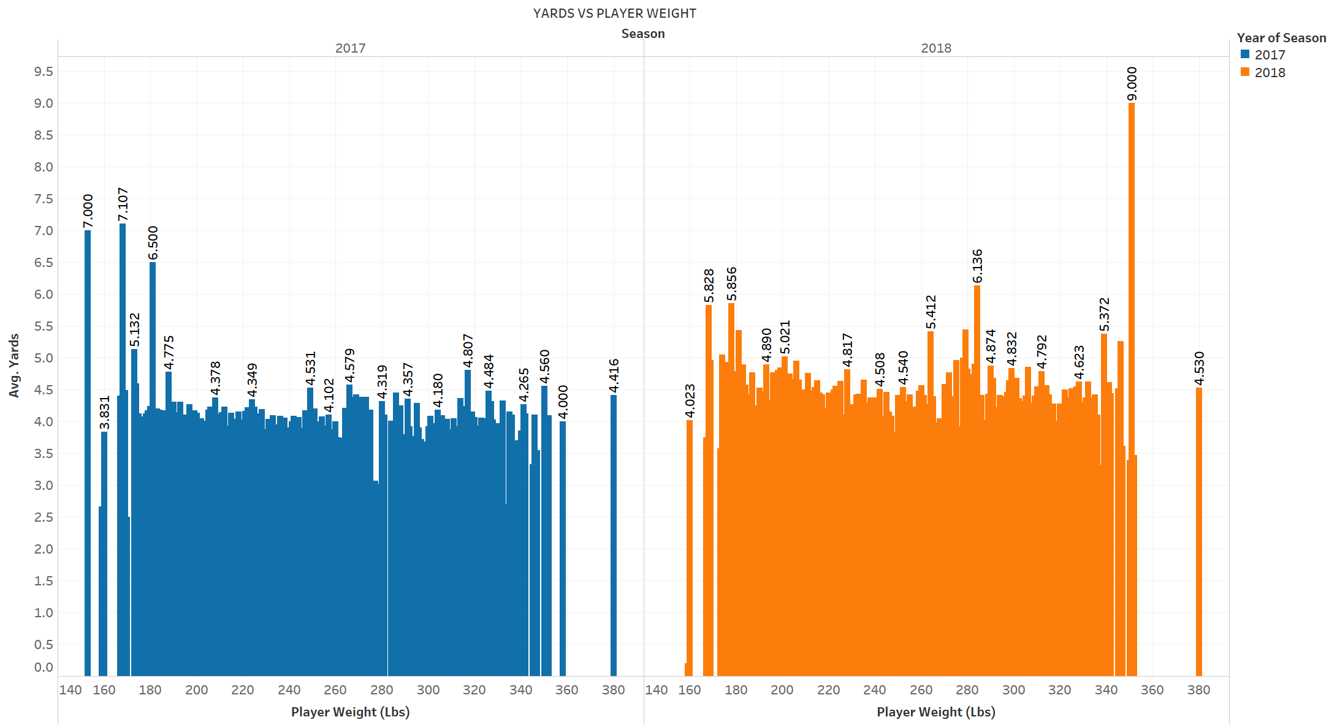
Player weight ranging from (270lbs to 290lbs) & (150lbs to 170lbs),not able to score more Yards.

Slide 24
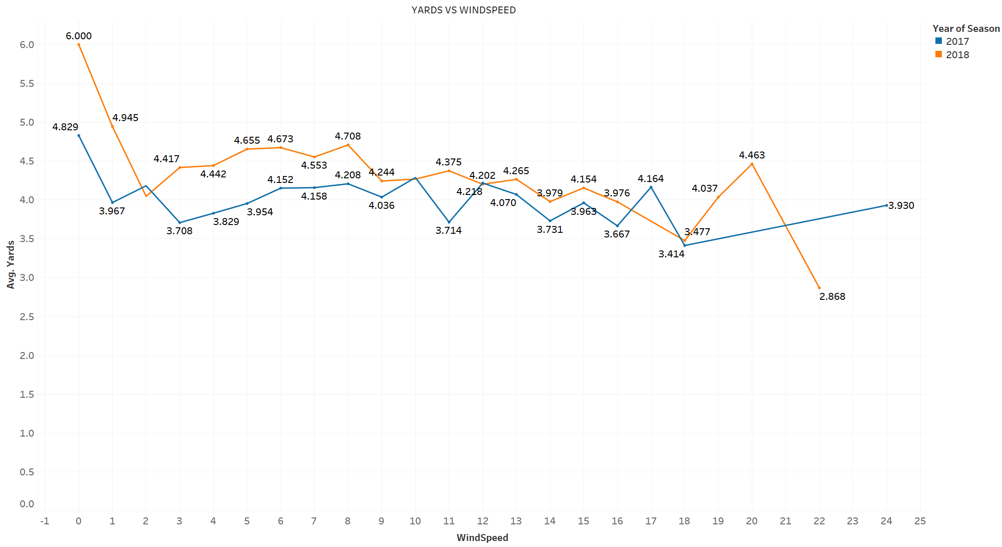
As the wind Speed Increases, Chances of scoring Yards gets decreases.

Slide 25
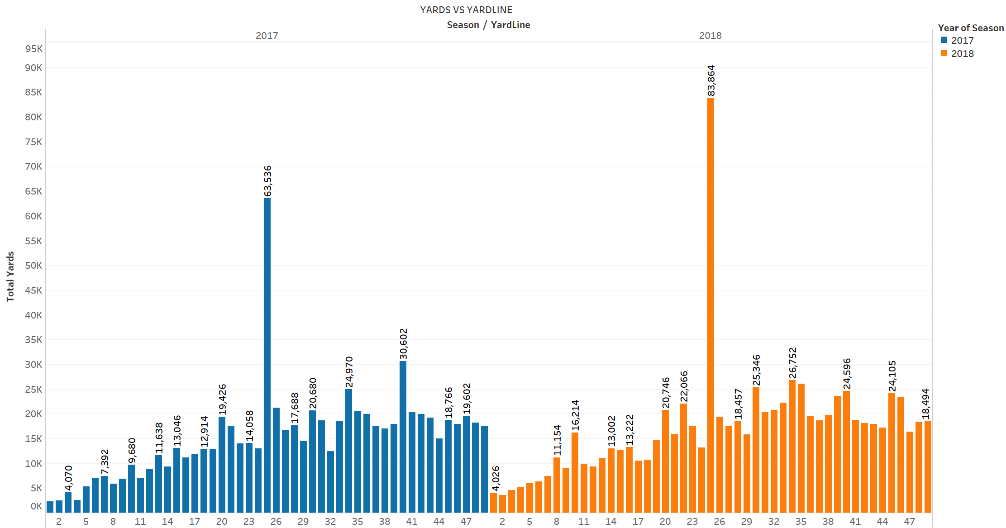
As we can Observe most number of Yards gained at Yard line 25 is more in both the Seasons.

Slide 26
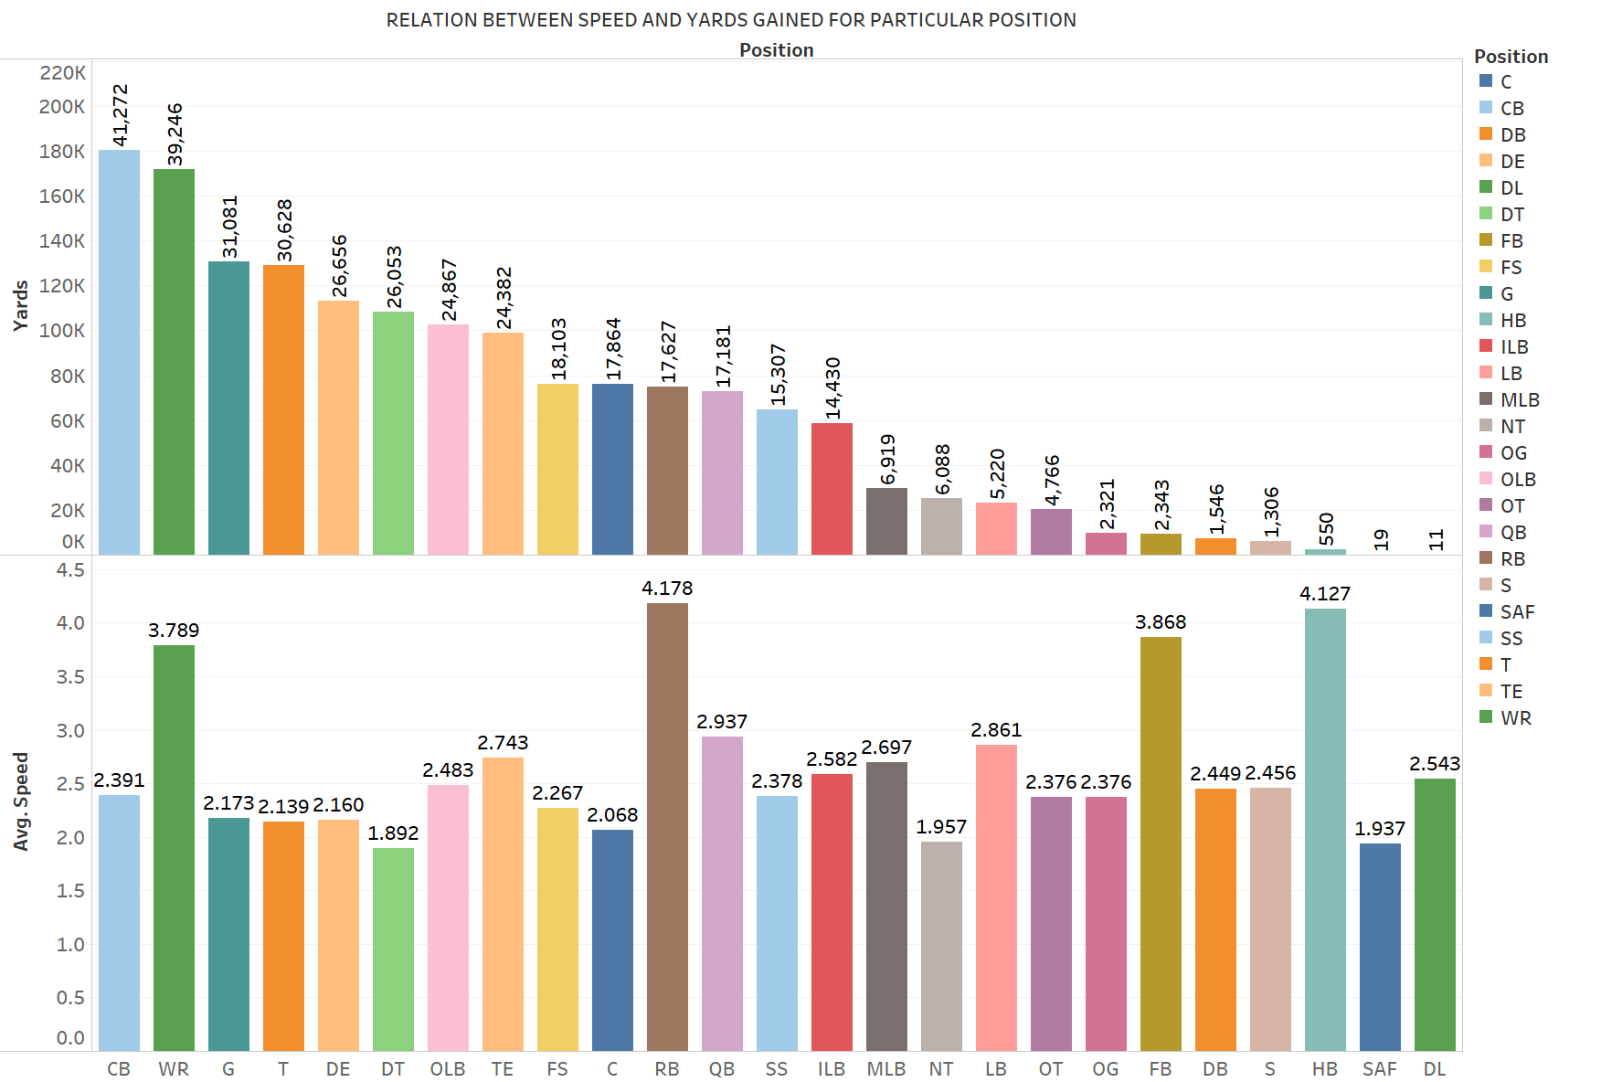

Slide 27
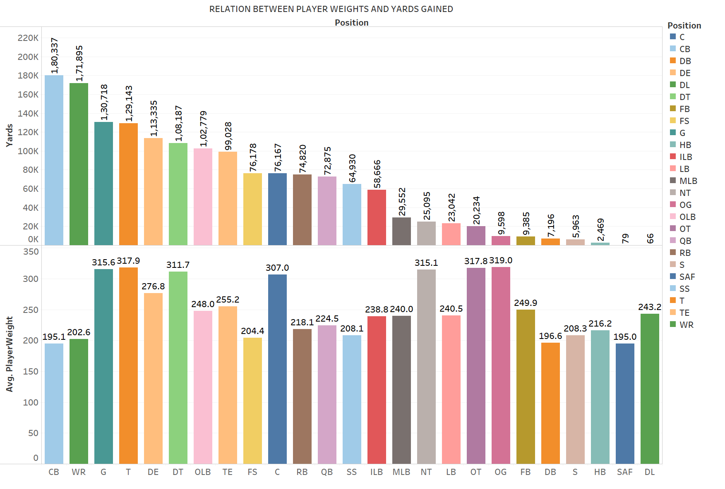

Slide 28
NFL
Using the below models, we would like to predict the number of yards an NFL player gained after receiving a handoff.

Slide 29
Predictive models used & Tuning procedure
Linear Models → Partial Least Squares(PLS),Principal Component Regression(PCR),Principal Component Analysis(PCA),Penalized Regression Model(Ridge & Lasso)
Non-Linear Models → Extreme Gradient Boosting(XGBOOST),Random Forest
Tuning Procedure:
Predictive Models | Tuning Parameters
PLS,PCR | ncomp
Ridge, Lasso | Lamda
XGBOOST | Nrounds, max_depth, eta,gamma, colsample_bytree, min_child_weight, subsample
Random Forest | Mtry

Slide 30
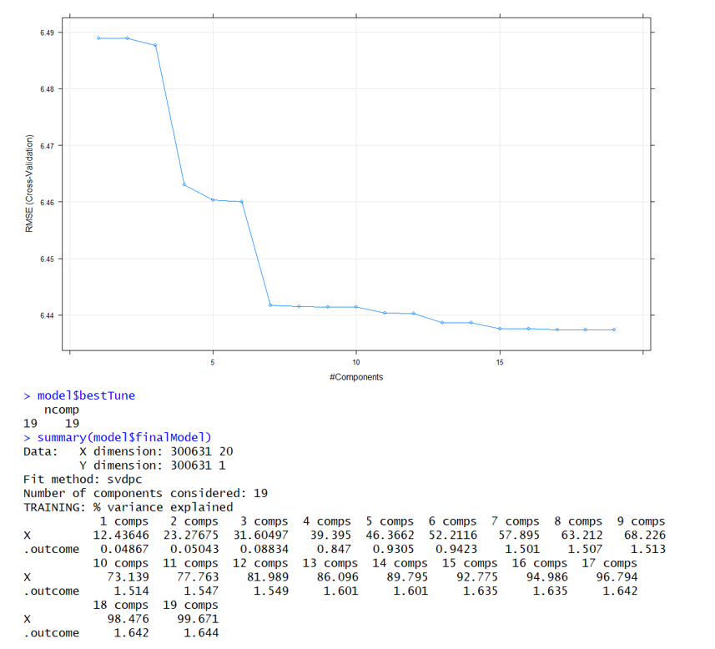
PCR
NFL
86.09% of the Variance is explained by 13 components

Slide 31
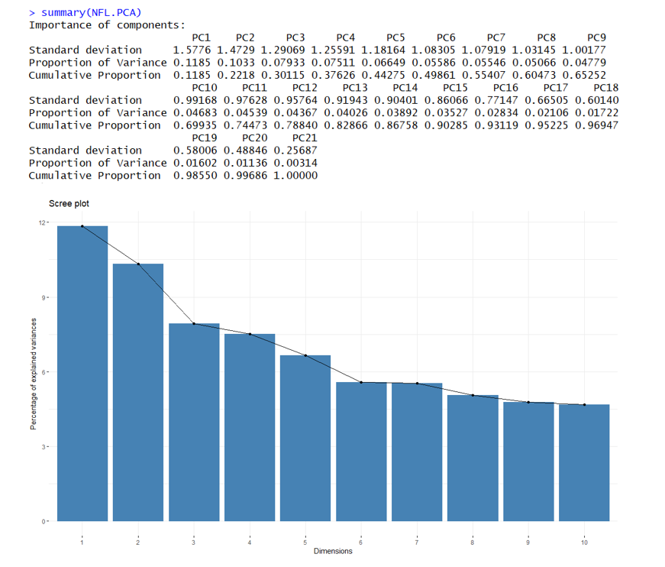
PCA
NFL
82.8% of variance was explained by 13 Components.
When compared to PCR,PCA explains 3.29% less variance for 13 Components.

Slide 32
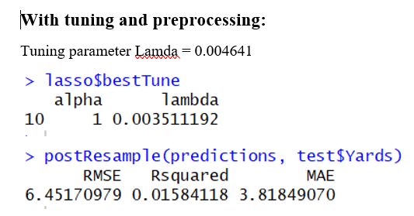
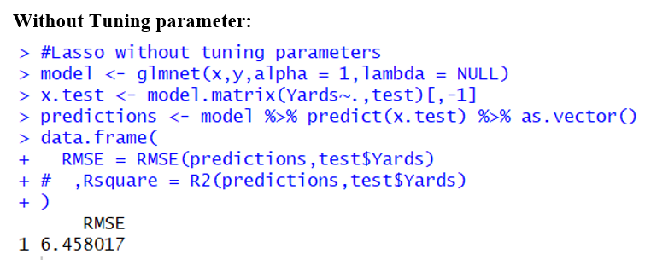
LASSO
NFL
The difference between RMSE is 0.0063, Before applying 10-fold cross validation we have RMSE of 6.458107 and after applying 10-fold cross validation we have an RMSE value of 6.451709 and R^2 value of 0.01584.

Slide 33
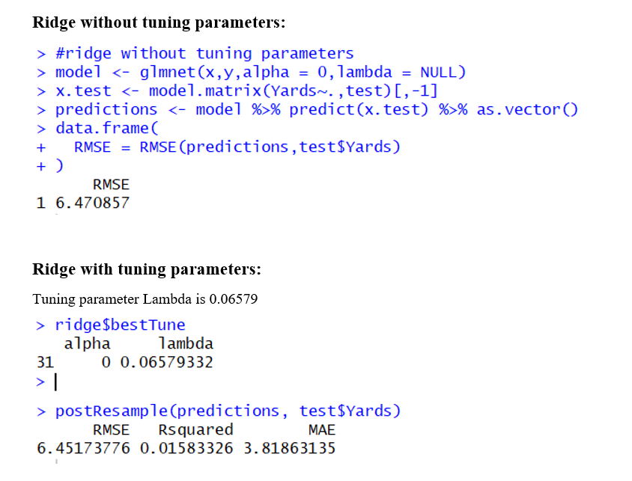
RIDGE
NFL
The difference between RMSE is 0.0190, Before applying 10-fold cross validation we have RMSE of 6.470857 and after applying 10-fold cross validation we have an RMSE value of 6.4517377 and R^2 value of 0.01583.

Slide 34
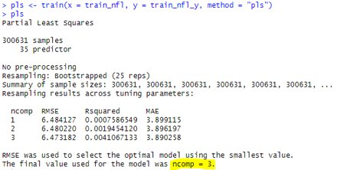
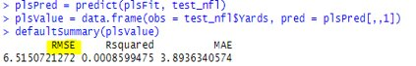
PLS (PARTIAL LEAST SQUARES)
NFL
We are training the data with method PLS without applying cross validation here. Where we get the result of 'ncomp=3' as the final value. And the RMSE value before cross validation is 6.51507

Slide 35
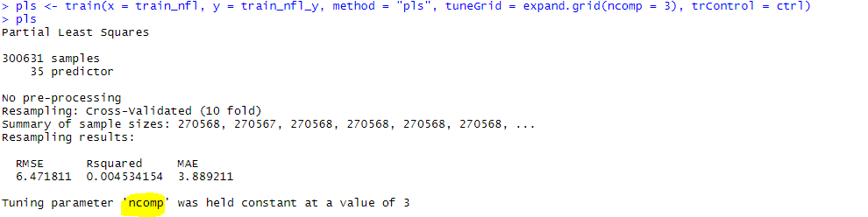
PLS (Cross Validation)
NFL
We have applied 10-fold cross validation here. After applying cross validation , we have RMSE as 6.504466751.The difference between RMSE is 0.010605. Even we see a change in R squared value too.

Slide 36
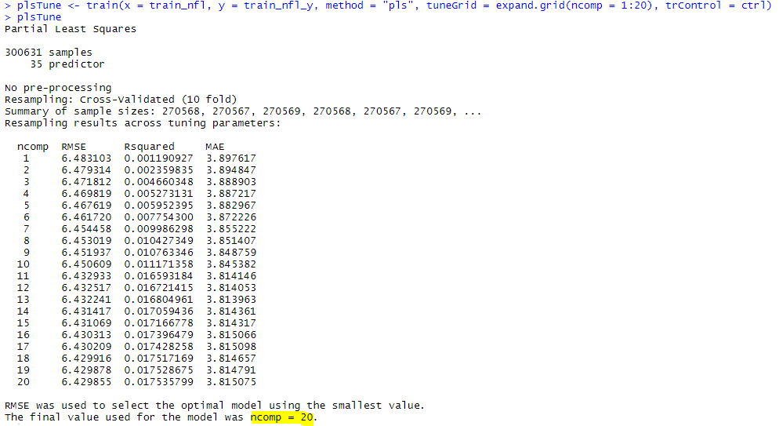
Model Tuning:
NFL
Tuning the parameters of PLS , i.e. : 'ncomp'

Slide 37
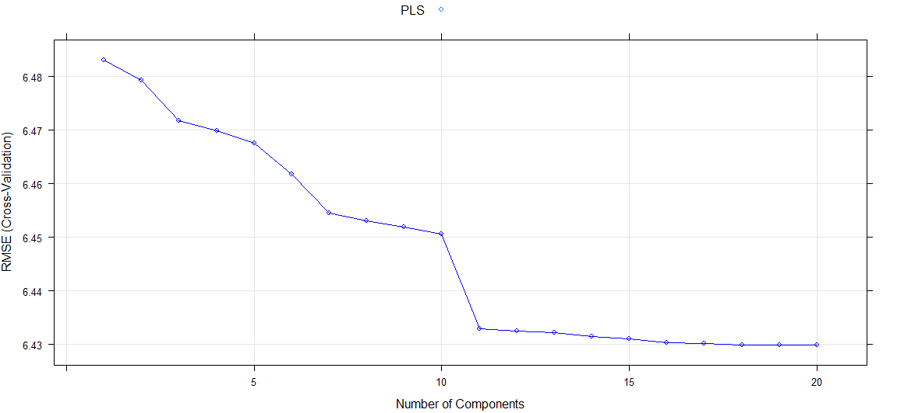
PLS Plotting
NFL

Slide 38
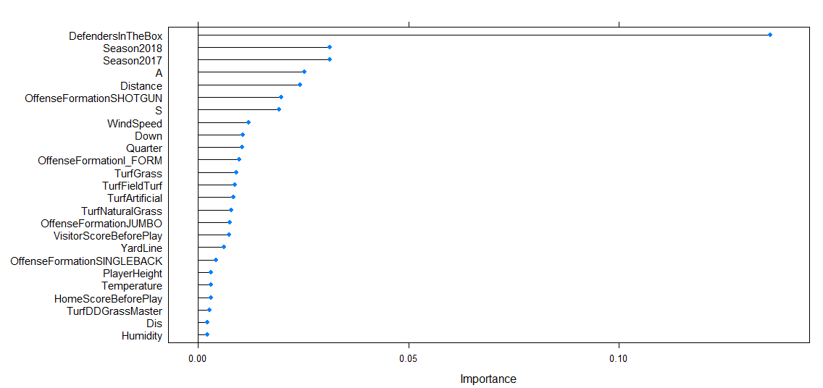
PLS Variable Importance PLOT:
NFL
According to pls method, the attribute 'Defenders in the box' has high variable importance.

Slide 39
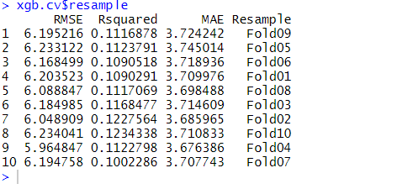
10-FOLD CROSS VALIDATION RMSE’S FOR XGBOOST
NFL

Slide 40
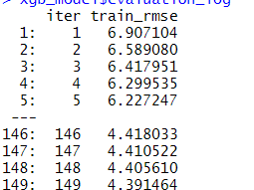
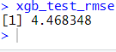
TRAIN AND TEST RMSE’S AFTER 10-FOLD CROSS VALIDATION FOR XGBOOST
NFL
We have a train RMSE of 4.3914 and test RMSE of 4.46834

Slide 41
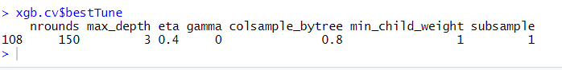
Best TUNING PARAMETERS FOR XGBOOST AFTER 10-FOLD CROSS VALIDATION

Slide 42
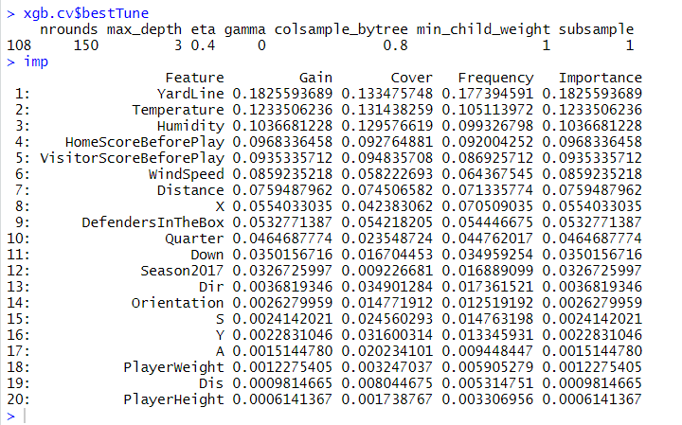
VARIABLE IMPORTANCE VALUES FOR ALL THE VARIABLES (predictors) in xgboost
NFL

Slide 43
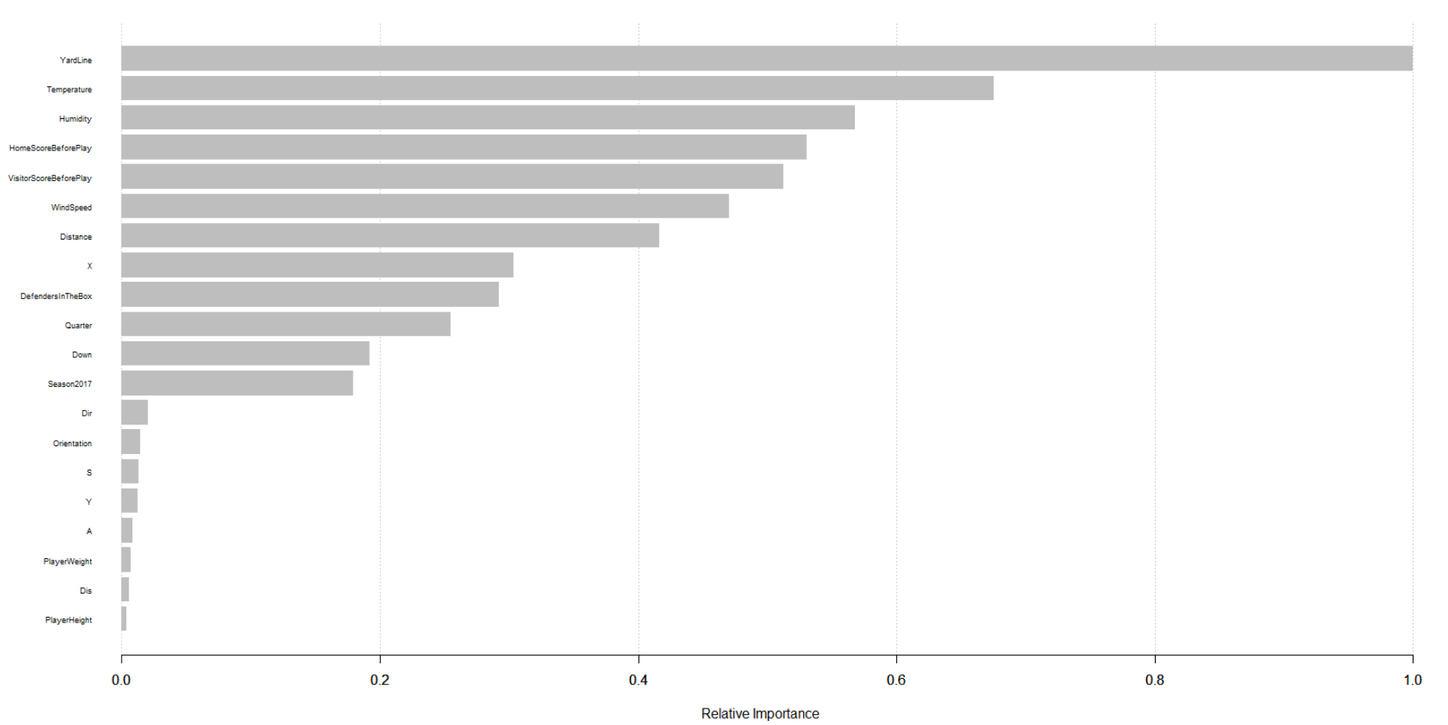
XGBOOST
NFL
The most important variables to predict our response variable (Yards) are in descending order

Slide 44
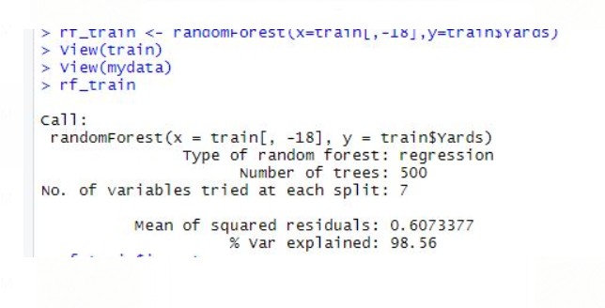
RANDOM FOREST REGRESSION MODEL RESULTS
Variance explained by Random forest is 98.56% with trees =500 and number of variables split at each
node is 7. RMSE value is 0.779102

Slide 45
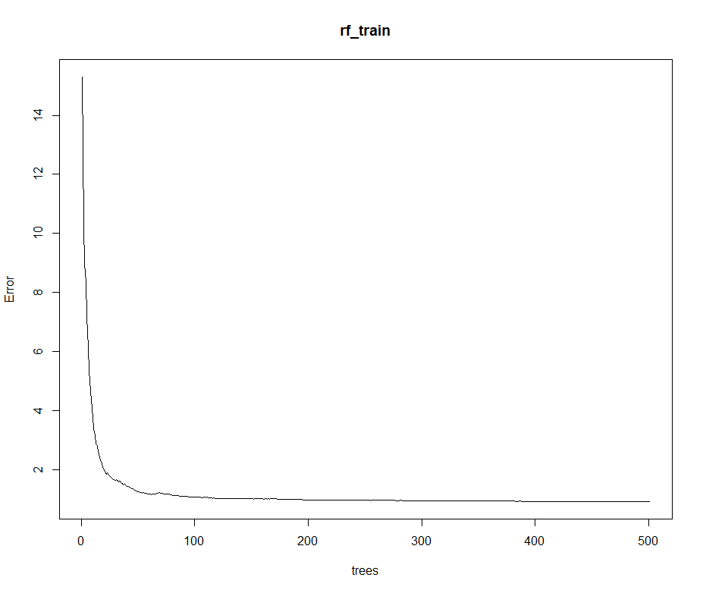
RANDOMFOREST TREE PLOT
As the number of trees increases from 0 to 80 error gradually decreases, after reaching above 100 the error remains constant. From this we can choose ntree values between 100 to 150.

Slide 46
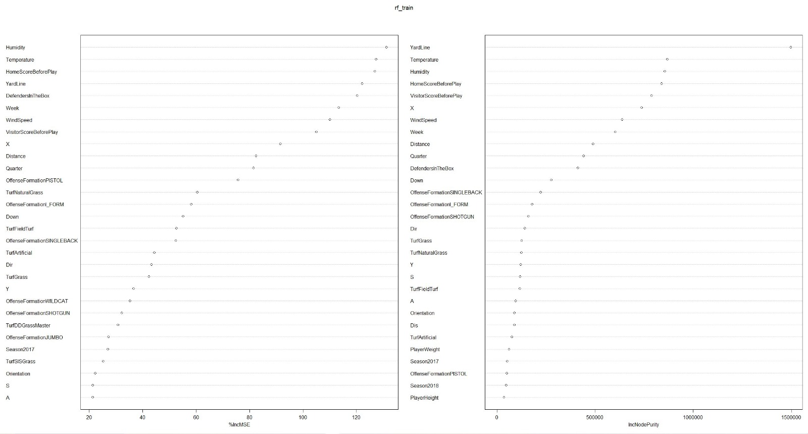
RANDOM FOREST

Slide 47
PREDICTIVE MODELS | TEST RMSE VALUES
LASSO(W/o Tuning) | 6.458017
LASSO(with Tuning) | 6.451709
RIDGE(W/o Tuning) | 6.470857
RIDGE(with Tuning) | 6.451737
XGBOOST(with Tuning) | 4.468348
RANDOM FOREST(with Tuning) | 0.779102
PLS(with Tuning) | 6.504466
PCR(with Tuning) | 6.4517377

Slide 48
 | XGBOOST | RANDOM FOREST
Yard Line | 1 | 1
Temperature | 2 | 2
Humidity | 3 | 3
Humidity score before play | 4 | 4
Visitor score before play | 5 | 5
Windspeed | 6 | 7
Distance | 7 | 9
X | 9 | 6
Defenders in the Box | 10 | 11
Quarter | 11 | 10
Down | 12 | 12
Season2017 | 13 | 27
Dir | 14 | 16
Orientation | 15 | 23
S | 16 | 20

Slide 49
NFL
Deeper insight into rushing plays will help teams, media, and fans better understand the skill of players and the strategies of coaches.
Moreover also assists the NFL and its teams evaluate the ball carrier, his teammates, his coach, and the opposing defense.
NFL aims to provide better context into what contributes to a successful run play.

Slide 50
THANK YOU

Slide 51
QUESTIONS ?

